Slide 1
Flower Defense
Team NoName
A fun, action-filled tower defense game based around defending a forest from an onslaught of robots.
Notes:
Kevin

Slide 2
Plot
Robots are planning on destroying the forest to use for resources.
The plants of the forest are fighting to defend their home.
It’s up to the plants to stop the robots from getting through the forest clearing back to their base.
Notes:
Kevin

Slide 3
Objective
Stop all the robots from getting through the clearing.
If too many robots make it through, they will have enough resources to destroy the entire forest and you lose.
If you make it through all the waves of robots, you win!
Notes:
Kevin

Slide 4
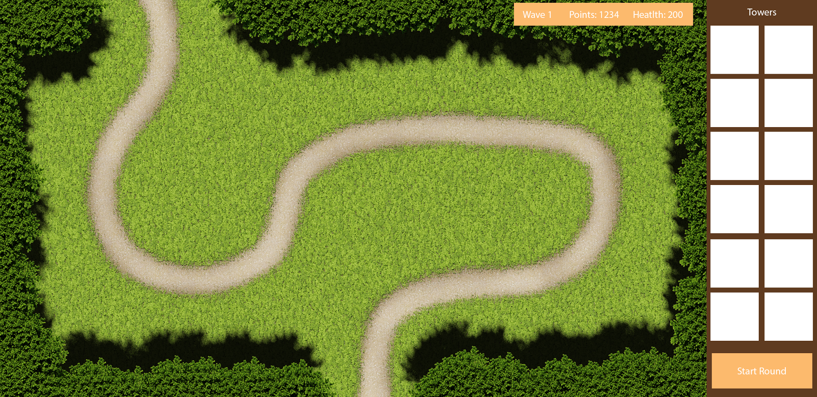
UI Rough Concept
Notes:
Sawyer

Slide 5
Rules
Every time a robot makes it through the clearing, you lose a health point.
Defeating a robot gives you points that you can spend to build or upgrade your defenses.
Harder robots give you more points, but cost more health if they get through.
Each wave will have an increasing amount of robots spawning that may be more difficult to defeat.
After each wave, you will have time to build your defenses before the next wave appears.
You can’t place defenses too close to others.
Notes:
Kevin

Slide 6
Tower ideas
Seed shooter - single direction/omni-directional (hits one enemy at a time)
Upgrades: longer range, shoots faster
Venus fly trap - bites nearby enemies (initially only one enemy)
Upgrades: quicker cooldown, can hit multiple enemies with one bite
Flower petal - boomerang/omni-directional (pass through enemies)
Upgrades: longer range, shoots faster
Vine wall - stops enemies for a certain amount of time, but has a long cooldown
Upgrades: stays up longer, quicker cooldown
Notes:
Tavi

Slide 7
Tower ideas
Water gourd - Drops water onto enemies periodically
Wash robots back a bit and short-circuit them for a small period of time
Upgrades: pushes enemies farther back, short-circuited for longer, quicker cooldown
Maple tree - squirts maple syrup sap onto the road and slows enemies down
Upgrades: Slows enemies down even more, covers larger stretch of path with sap
Notes:
Tavi

Slide 8
Robot ideas
Drone escort - flies over obstacles on road
Rover - variants: small and fast, armored but slower
Carrier - once destroyed, smaller robots come out and must be defeated as well
Boss - large, slow-moving rover that destroys defenses as it goes, but defenses regrow after wave is over
Notes:
Tavi

Slide 9
UI Rough Concept
Notes:
Sawyer

Slide 10
Prototype Ideas
Enemies walking along a path - might be difficult to implement
Planting a tower on the map
Upgrading a tower
Towers firing at enemies in range
Choosing multiple maps from menu
Notes:
Sawyer

